Slide 1
University Community
Report and Response App
By:
Abimbola Adeyemi
Cameron L’Ecuyer
Project Supervisor:
Professor Baek-Young Choi

Slide 2
Team Member Contributions
Abimbola Adeyemi – Provided inspiration for the project idea, wrote the project proposal, helped write the project demonstration, and coded the Android login pages
Cameron L’Ecuyer – Activated the Amazon EC2 and RDS instance, wrote the PHP scripts for the web server, wrote the web page, wrote the report and task list page for Android, hooked Android up to the web server using REST services, wrote the mid-semester report, helped write the project demonstration, and wrote this report
Link to the project GitHub: https://github.com/camlecuyer/CloudComputeProject

Slide 3
Contents
Problem Statement
Objective of Project
Introduction
Significant of project
Technologies Used
Overview of the System
Application
Challenges and Solutions

Slide 4
Problem Statement
Through observation, and contact with members of the Facilities Division, we have discovered that UMKC lacks an application that allows students, faculty, and staff to report issues to the Facilities Division
This slows the speed at which problem are discovered and corrected
Our contact, Randy Shingleton, Director of Facilities Operations at UMKC, mentioned that the school has Campus Eye, which allows them to communicate with the other divisions, but it is not approved for students, faculty, and staff to use

Slide 5
Objectives of the Project
Develop a mobile application that would allow students, faculty, and staff to report problems quickly with sufficient detail to the Facilities Division
Develop a web page to allow members of the Facilities Division to view the issues and then create tasks for members of the various facilities teams view, find, and then correct the problems

Slide 6
Introduction
This app was created to provide service to UMKC campus community
Example of some issues are:
Broken toilets/sinks
Burned out light bulbs
Broken door locks
Overflowing trash cans

Slide 7
Significance of the Project
To contribute to the development of quick response to problems before they require emergency attention
To make a very flexible app that provides prompt response for non emergency issues
To create an avenue where non emergency issues can looked at from a different perspective by the administrators

Slide 8
Technologies Used
Amazon AWS EC2 Web Server Instance running Linux with Apache and PHP, and hosting web page
The decision to use the EC2 node, was that from research into the problem, it was not wise to directly connect an Android app to a database, as it could lead to security breaches
I used Linux, PHP, and Apache as it was cheaper than a Windows OS and its technologies, and the tutorial for Amazon AWS used Linux, Apache, and PHP for its free tier
Amazon AWS RDS Server running MySQL
Originally, I had hoped to use Microsoft SQL Server as I was more familiar with it, and already had some of the tools downloaded
Since I was using PHP, it was easier to use MySQL than SQL Server

Slide 9
Technologies Used (cont’d)
Android Studio to develop Android App
Android was used, as I had the tools to develop and test Android
Google Volley for REST services in Android
Angular and JQuery for business logic in the web page
JQuery was used to do POST methods as Angular’s POST method converts it’s parameters into JSON format, which PHP does not understand by default
Bootstrap, CSS, and HTML for web page UI

Slide 10
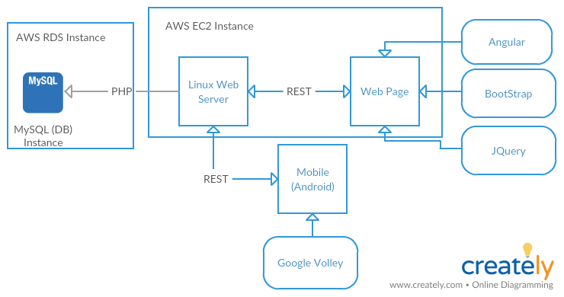
Overview of the System

Slide 11
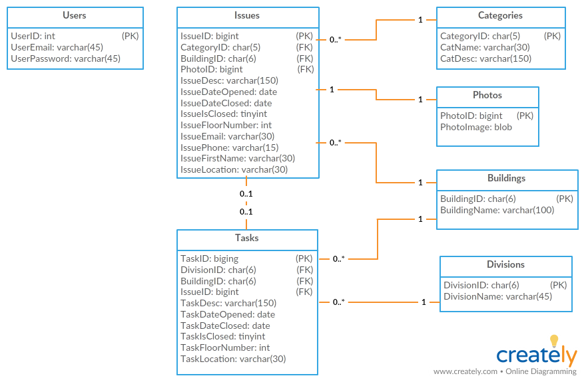
Overview of the System

Slide 12
Application
Demos of the project can be found at:
Mobile App: https://www.youtube.com/watch?v=SiMKq2Il4K8
Web App: https://www.youtube.com/watch?v=Lf1oVD0yFW0

Slide 13
Challenges and Solutions
The first major challenge was, problems with REST services in the various languages:
REST calls using JSONObjectRequest in Android would not accept parameters
Solution: Used StringRequest calls, as they accept parameters, and converted response to JSON Object
Angular POST calls convert parameters to JSON object which PHP does not natively understand
Solution: Used JQuery POST calls instead

Slide 14
Challenges and Solutions
The second challenge was, problems retrieving images from the database:
The original idea was to convert images to base64 and store them in the database (that was proven to be a bad idea, but I did not have time to rework the system to fix it), I could store the images easily, but retrieving them was proving to be a problem
I believe PHP was not retrieving data properly using prepared statements and SQL Joins
Solution: Break image retrieval into its own file, and return just the image, and use an img tag in HTML to retrieve the image

Slide 15
Challenges and Solutions
The third challenge was, CORS:
Android had no problem accessing the data from the web page, but the web app had problems dealing with CORS
Solution: I learned how to configure PHP pages with CORS headers

Slide 16
Challenges and Solutions
The fourth challenge was, using charts:
I did not want to have to use NPM modules to run charts on the webpage, and when I finally found a solution that did not need NPM, the pie charts were not working correctly
Solution: used bar charts instead

Slide 17
Challenges and Solutions
The fifth challenge was, miscommunication:
Before spring break, me and Abimbola talked about who would work on what part of the project, I had thought she said she would work on the web app, and I would work on Android, but during spring break she sent me a message saying she was working on Android
Solution: I still had to work on Android to ensure the REST services would work, but I also started working on the web app

